Slide 1
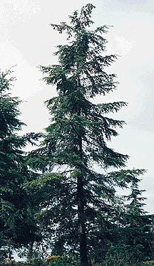
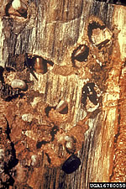
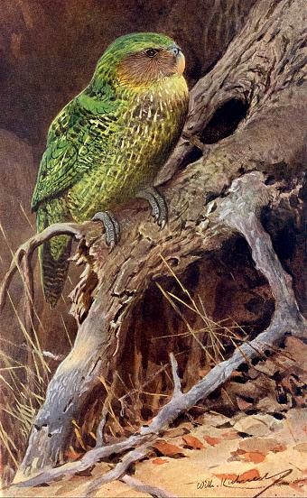
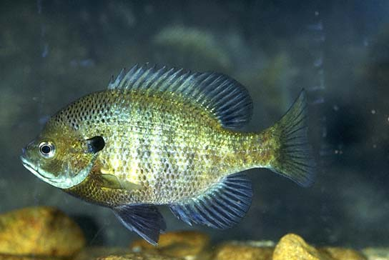
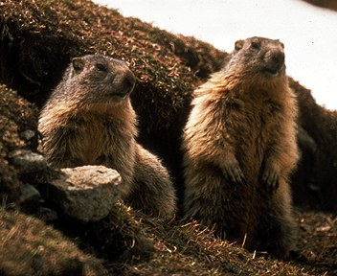
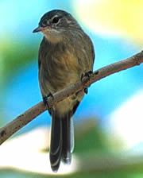
Lecture 3:
Density Dependence

Slide 2
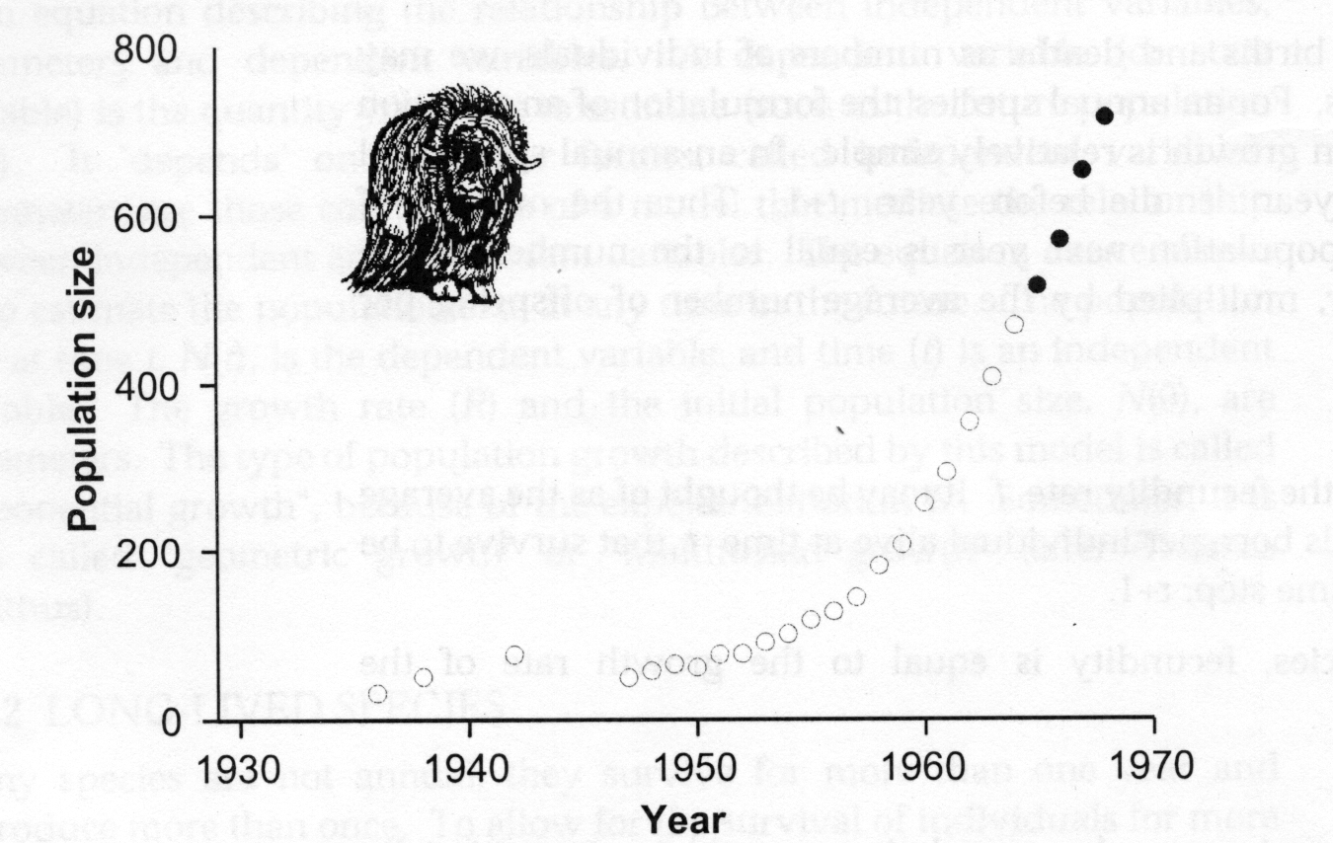
Muskox- exponential population growth for 30 years

Slide 3
Effects of Crowding

Slide 4
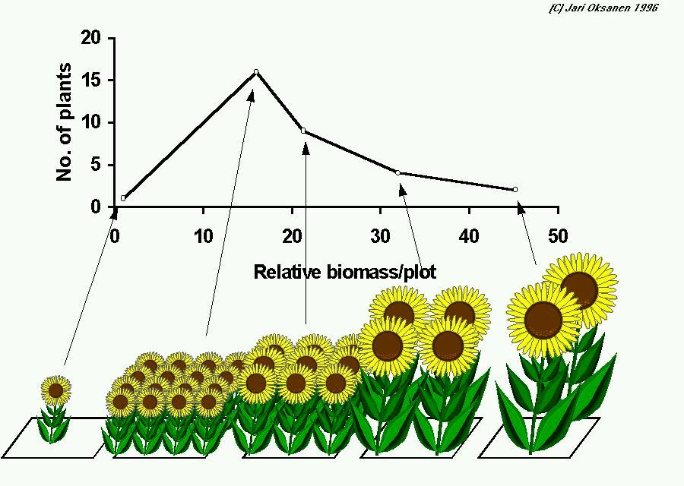
Forestry: Thinning

Slide 5
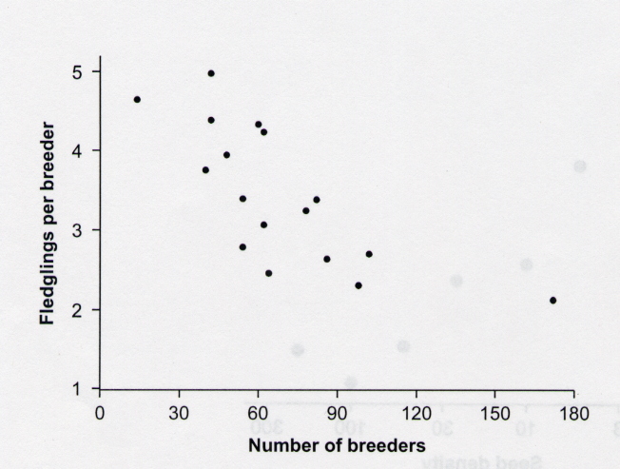
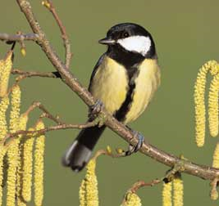
Birth rates decrease with density

Slide 6
Density dependence

Slide 7
Types of density dependence
Scramble competition- a resource is shared equally among individuals- as the population size increases the amount of resource per individual decreases.
Contest competition- resources are shared unequally- as the population size increases some individuals get enough resources to survive and reproduce and some do not.

Slide 8
Scramble Competition
Newly hatched fish- competition for food
If density is low- all of them survive.
If density is high- all of them die
Contest competition

Slide 9
Modeling Density Dependence
Determine what causes density dependence and add the appropriate equations to our model.

Slide 10
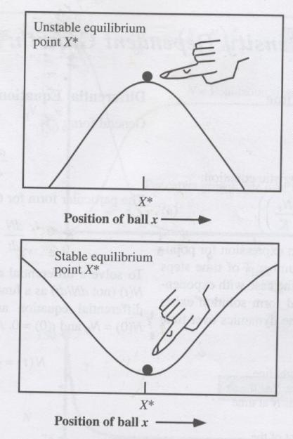
Types of equilibrium
Unstable equilibrium
Stable equilibrium

Slide 11
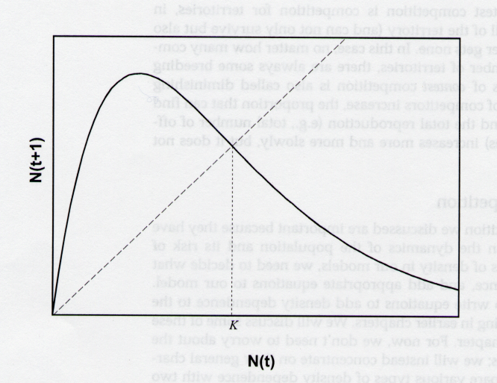
Scramble Competition

Slide 12
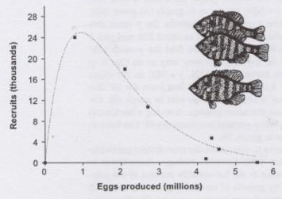
Scramble Competition
Bluegill (Lepomis macrochirus)

Slide 13
Discrete logistic equation

Slide 14
100
100
N_{t+1}=N_{t}
80
80
60
60
N_{t+1}
N_{t}
K
40
40
20
20
0
0
0
20
40
60
80
100
0
1
2
3
4
5
6
7
N_{t}
Time
R = 1.6, N₀=20, K = 50

Slide 15
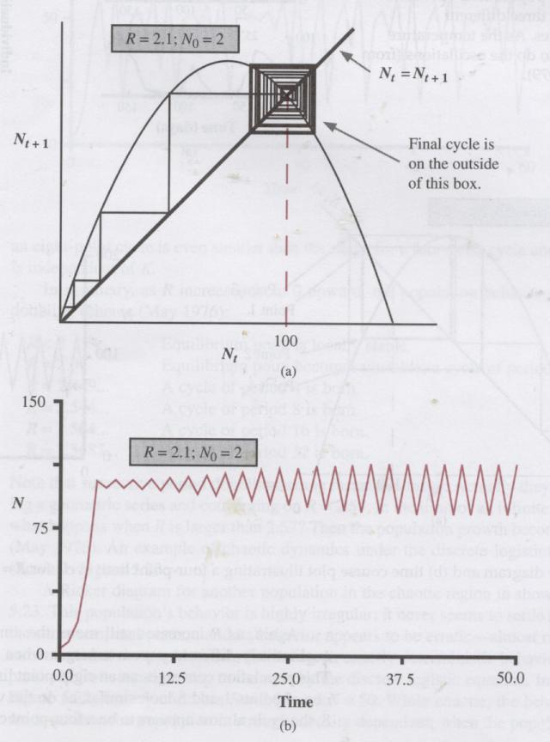
Increase R to 2.1
R = 2.1, N₀ = 2, K = 100
Stable 2-point cycle

Slide 16
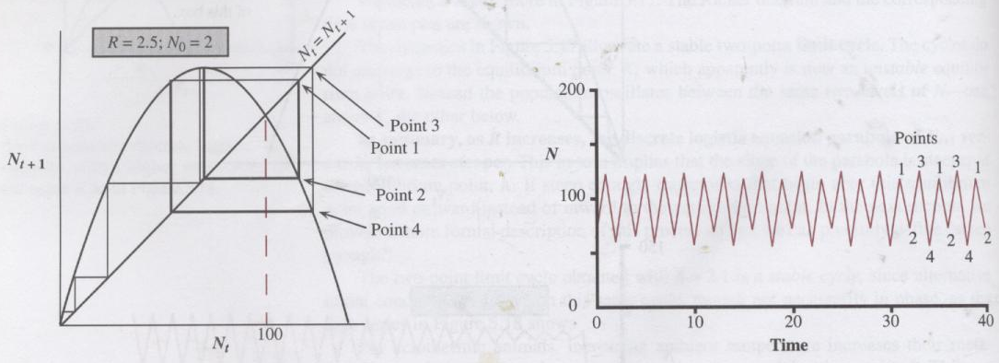
R = 2.5, N₀ = 2, K = 100
Stable 4-point cycle

Slide 17
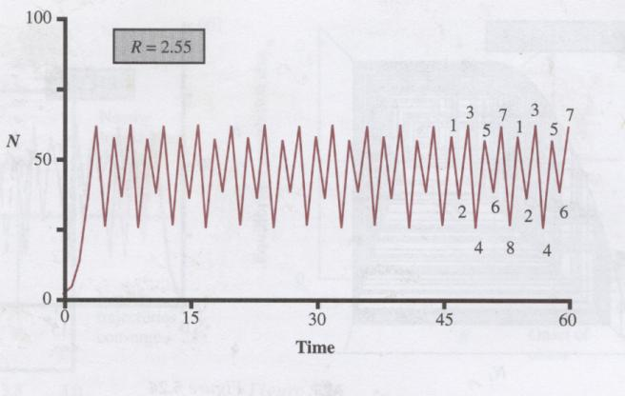
R = 2.55, N₀ = 2, K = 50
Stable 8-point cycle

Slide 18
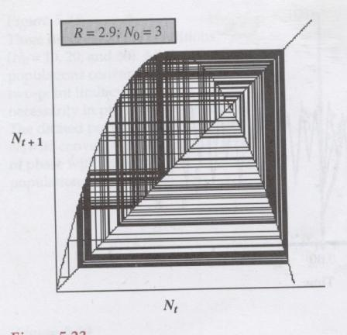
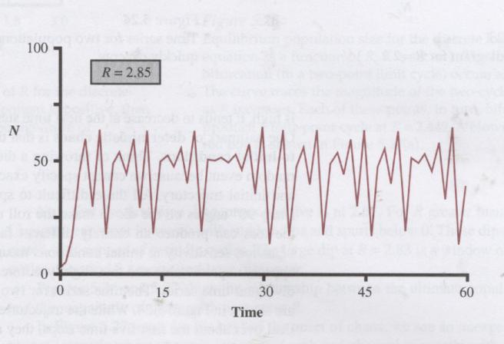
When R > 2.57, population growth becomes chaotic

Slide 19
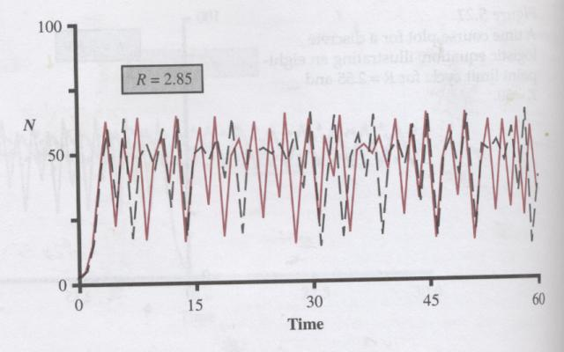

Slide 20
Range of R Dynamic behavior
R < 2.000 Stable equilibrium at K
2.000 < R < 2.449 Stable 2-point cycle
2.449 < R < 2.544 Stable 4-point cycle
2.544 < R < 2.564 Stable 8-point cycle
2.564 < R < 2.570 Larger-point cycles
R > 2.570 Chaos

Slide 21
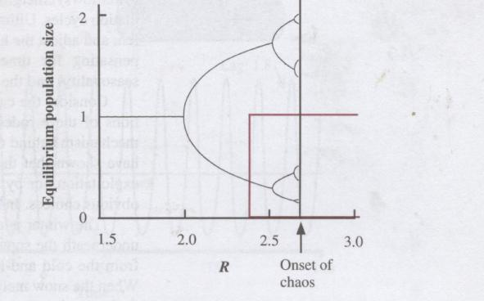
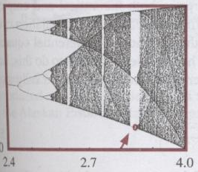
Bifurcation diagram
Equilibrium population size

Slide 22
Scramble
Competition
Exponential
N_{t+1}
N_{t+1}
N_{t}
N_{t}
N_{t+1}
N_{t}
1
N_{t}
N_{t}

Slide 23
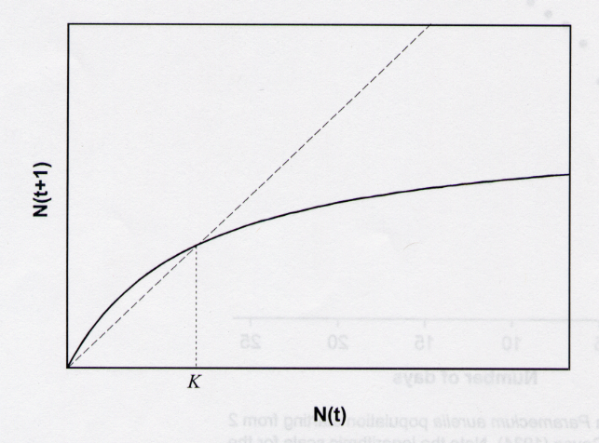
Contest competition

Slide 24
Equation- contest competition
R K N_{t}
N_{t+1} =
K + (R-1) N_{t}

Slide 25
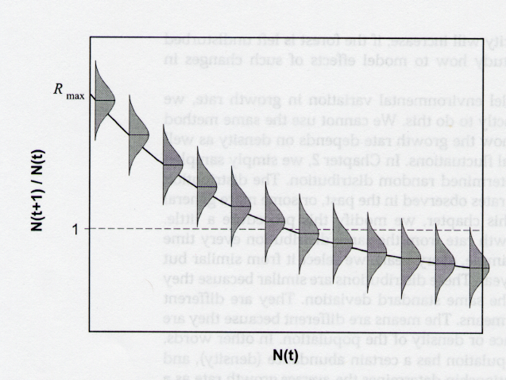
Adding Environmental Variation
R and K may be affected by environmental variation.
Consider variation in R. Change in population size from year to year depends on both population density and environmental variation.
N_{t+1}
N_{t}

